Slide 1
Stacks
EECE Department
ELC 303-B
Dr. Ahmed Khattab

Slide 2
Objectives
1. Understanding and applying the Stack ADT.
2. Applications of the Stack ADT.
3. Implementing a Stack using an array.
4. Implementing the Stack ADT as a C++ Class.
5. Implementing an ADT with C++ templates.
6. Implementing a Stack using a dynamic list.
7. Comparison of different stack Implementations.

Slide 3
Robot Navigation Problem
Lets suppose that we adopt the following basic strategy for the robot:
1. If possible, move in the direction of the target.
If there are two directions both of which move the robot closer to the target, choose one arbitrarily.
(strategies may be fixed or arbitrary)
2. If the robot can’t move toward the target, try any other move arbitrarily.

Slide 4
Initial conditions
T
R

Slide 5
The robot hits a dead end
T
R

Slide 6
backs up, tries new direction
T
R

Slide 7
Robot Navigation Problem
Based on our discussion above, we add the following rules to our algorithm:
3. As the robot moves, it marks the squares so that the robot doesn’t revisit them, except as indicated in rule 4.
4. When the robot reaches a dead end, it backs up through its previous positions until it finds an unexplored direction to try.

Slide 8
Backtracking
When base case is encountered we must backtrack
Go to the stack of previously visited squares
Pop them off one by one until a viable direction appears

Slide 9
Robot’s path to the target
T

Slide 10
The stack
The solution to this problem requires backtracking, which requires storing previously visited locations in reverse order
The last one visited is the first one you backtrack to
Such a structure is called a ‘stack’

Slide 11
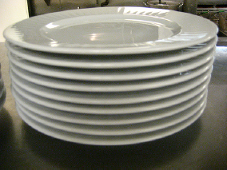
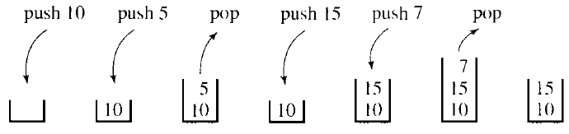
Classic stack example
Cafeteria trays, sheets of paper in a laser printer, etc.
LIFO
You ‘push’ items on
You ‘pop’ items off
Must always know where the top of the structure is
Must know if the stack is empty
Sometimes useful to know if it is full

Slide 12
Other Stack Applications
Reverse a word. (homework)
"undo" mechanism in text editors
Language processing, e.g. matching delimiter in a program.
  In C++, delimiters include (),[],{}, and /* .....*/.
  Mismatching delimiters indicates a code error.
Adding large numbers
Evaluating mathematical expressions

Slide 13
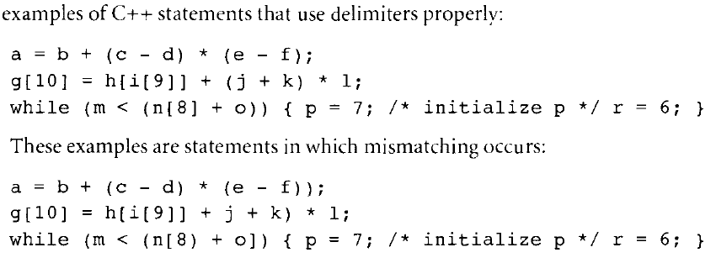
Matching Delimiter

Slide 14
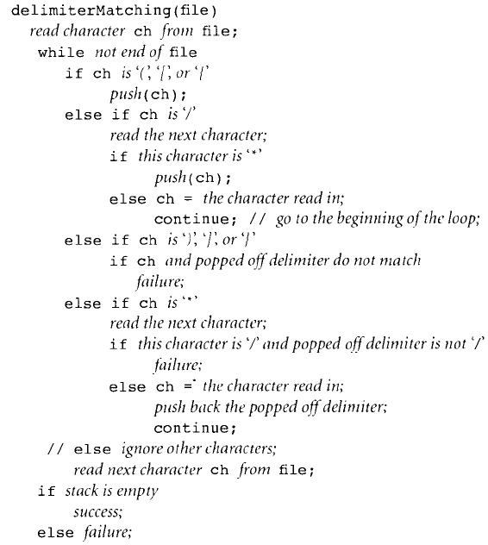

Slide 15
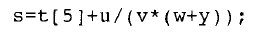
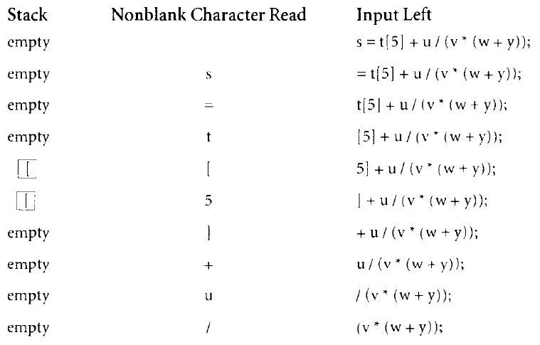
Example: Processing

Slide 16
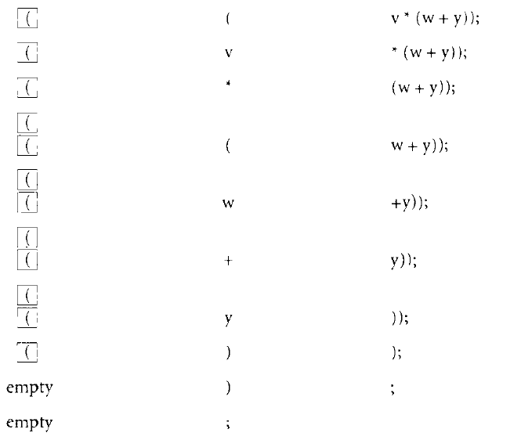
Example: Processing

Slide 17
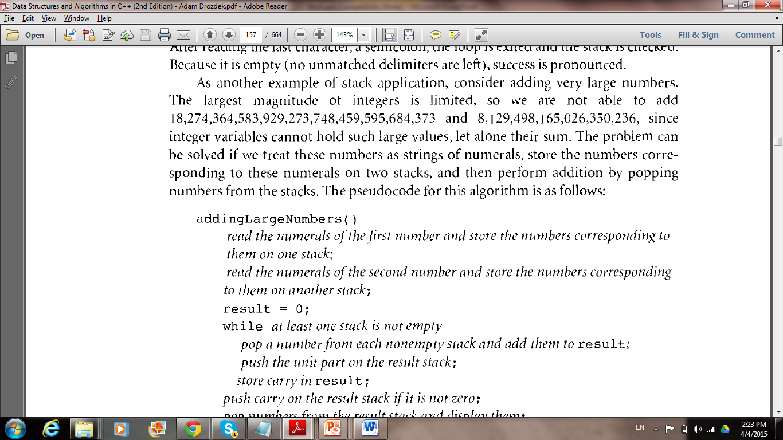
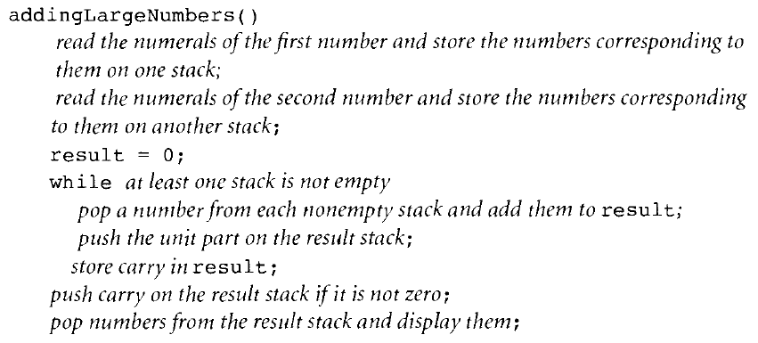
Adding Large Numbers
Add the following 2 numbers:

Slide 18
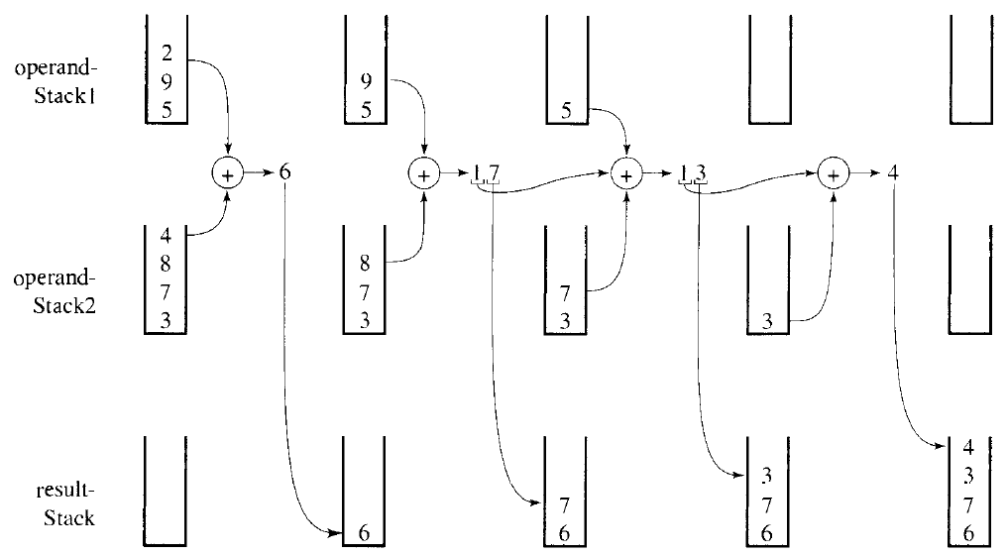
Example: Adding Large Numbers using Stacks

Slide 19
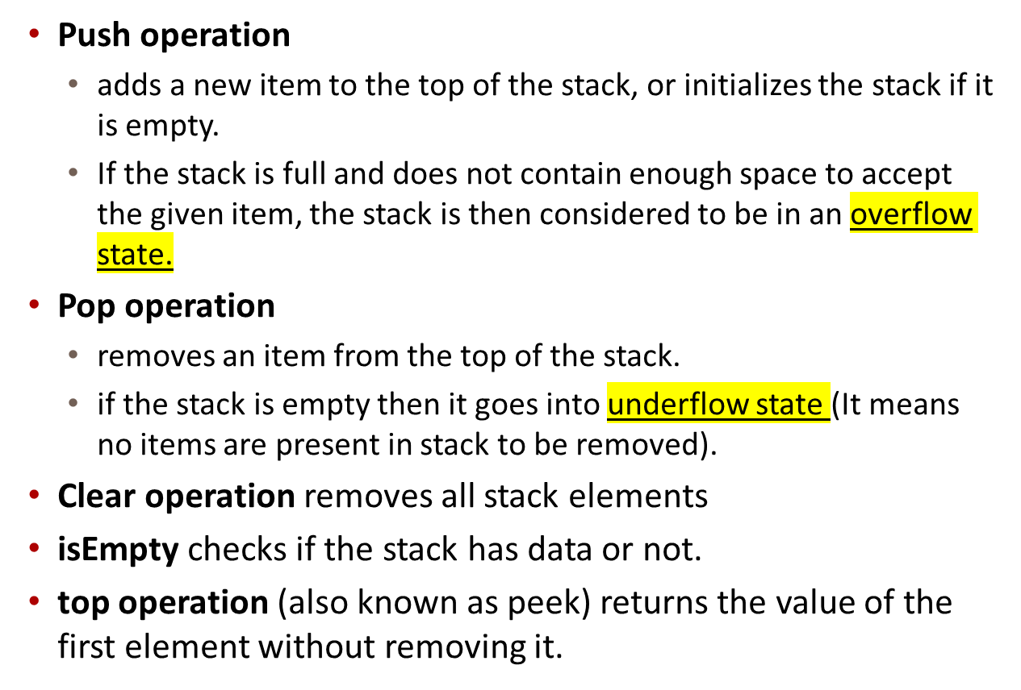
Stack Operations

Slide 20
Stack ADT (Abstract Data Type)
Characteristics:
• A stack S stores items of some type (stackElementType) in Last-In, First-Out (LIFO) order.
Operations:
stackElementType S.pop()
Precondition: !S.isEmpty()
Postcondition: S = S with top removed
Returns: The item x such that S.push(x) was the most recent invocation of push.

Slide 21
Stack ADT: push() and top()
void S.push(stackElementType)
Precondition: None
Postcondition: Item x is added to the stack, such that a subsequent S.pop() returns x.
stackElementType S.top()
Precondition: ! S.isEmpty()
Postcondition: None
Returns: The item x such that S.push(x) was the most recent invocation of push.

Slide 22
Stack ADT: isEmpty()
bool S.isEmpty()
Precondition: None
Postcondtion: None
Returns: true if and only if S is
empty, i.e., contains no
data items.

Slide 23
Stacks and lists
Stacks share many of the characteristics of lists, except they have a restriction on where data must be accessed or stored (only at the top)
Data in stacks is homogeneous
Use list-type implementations

Slide 24
Ways to implement stacks
Arrays
Linked lists (dynamic stacks)

Slide 25
Array implementations
What is wrong with the following example?

Slide 26
Array-based stack (version 1)
0
?
0
a
0
b
1
?
1
?
1
a
2
?
2
?
2
?
push('a')
push('b')
3
?
3
?
3
?
4
?
4
?
4
?
5
?
5
?
5
?

Slide 27
Problems
The top is fixed, therefore all access for storage (push) or retreival (pop) must go through it.
To keep it LIFO, the most recent item must be on top
As new items are added older items must shuffle down.
This is slow and unnecessary

Slide 28
A better implementation
Instead of fixing the top and moving the data, fix the data and move the top
As long as we know what top is we can still do all push and pop functions associated with LIFO

Slide 29
Version 2: floating top
top = -1
top = 0
top = 1
0
?
0
a
0
a
1
?
1
?
1
b
2
?
2
?
2
?
push('a')
push('b')
3
?
3
?
3
?
4
?
4
?
4
?
5
?
5
?
5
?

Slide 30
Code Example 8-1
// Code Example 8-1: Stack implemented using an Array
const int maxStackSize = 1000;
typedef char StackElementType;

Slide 31
Class Stack
class Stack {
public:
Stack();
void push(StackElementType item);
StackElementType pop();
StackElementType top();
bool isEmpty();
private:
StackElementType stackArray[maxStackSize];
int topIndex;
};

Slide 32
Header File Coding Tip
Avoid Multiple Header Inclusion
#ifndef _FILE_NAME_H_ // #ifndef – it stands for “if not defined”
#define _FILE_NAME_H_
/* code */
#endif // #ifndef _FILE_NAME_H_
By using the #ifndef directive, you can include a block of text only if a particular expression is undefined; then, within the header file, you can dene the expression. This ensures that the code in the #ifndef is included only the first time the file is loaded.

Slide 33
Stack constructor
// cx8-2.cpp
// Code Example 8-2: Implementation file, stack implemented using an Array
#include "cx8-1.h"
Stack::Stack()
{
topIndex = -1;
}

Slide 34
push( ) and pop( ) methods
void Stack::push(StackElementType item)
{// ensure array bounds not exceeded
assert(topIndex < maxStackSize-1);
++topIndex;
stackArray[topIndex] = item;
}
StackElementType Stack::pop()
{ // ensure array bounds not exceeded
assert(topIndex >= 0);
int returnIndex=topIndex;
--topIndex;
return stackArray[returnIndex];
}

Slide 35
top( ) and isEmpty( ) methods
StackElementType Stack::top()
{
// ensure array bounds not exceeded
assert(topIndex >= 0);
return stackArray[topIndex];
}
bool Stack::isEmpty()
{
return bool(topIndex == -1);
}

Slide 36
Other Variants
Instead of fixing the maximum stack size using
const int maxStackSize = 1000;
one can initialize the maximum stack in the constructor (how?)
  Gives more freedom in using the stack ADT
A destructor ~Stack ( ) can be used to de-allocate the used space
  delete [] stackArray;
Different other ways to implement Push and Pop
  e.g., they can be made as bool to return whether or not the operation was successful instead of using assert()
  Call be reference can be used to pass/get the stack value

Slide 37
Templates
Templates are C++ tools that can be used to create generic classes
Regular stack classes consist of one designated data type (from last example):
const int maxStackSize = 1000;
typedef char StackElementType;
private:
StackElementType stackArray[maxStackSize];

Slide 38
Templates (continued)
To use the previous code with a stack consisting of an array of ints, instead of chars, we would have to rewrite portions of it.
A stack template would not have to be rewritten. The original class definition would be generic, allowing us to later declare a stack of any designated type. Example:
int main()
{ Token t;
Stack < double > s;
double op1, op2;
bool done(false);

Slide 39
Pros and cons of templates
Templates are not necessary if your ADT
  Addresses only a specific client need
  Is not intended for reuse
Templates are necessary if your ADT is
  Intended to be a general solution
  Intended to be reused
  Intended to work with any client

Slide 40
template syntax
‘template <class YourType>’ becomes part of the class definition and must also become the leading part of every member function.

Slide 41
Stack template class
// cx8-3.h
// Code Example 8-3: Stack declaration rewritten as a templated class
const int maxStackSize = 1000;

Slide 42
Code Example 8-3
template < class StackElementType >
class Stack {
public:
Stack();
void push(StackElementType item);
StackElementType pop();
StackElementType top();
bool isEmpty();
bool isFull();
private:
StackElementType stackArray[maxStackSize];
int topIndex;
};

Slide 43
Template constructor
// Code Example 8-4: Definition of Stack member functions using templates
#include "cx8-3.h”
template < class StackElementType >
Stack < StackElementType >::Stack()
{
topIndex = -1;
}

Slide 44
Stack template push( )
template < class StackElementType >
void Stack < StackElementType >::push(StackElementType item)
{
// ensure array bounds not exceeded
assert(topIndex < maxStackSize-1);
++topIndex;
stackArray[topIndex] = item;
}

Slide 45
Stack template pop( )
template < class StackElementType >
StackElementType Stack < StackElementType >::pop()
{
// ensure array bounds not exceeded
assert(topIndex >= 0);
int returnIndex(topIndex);
--topIndex;
return stackArray[returnIndex];
}

Slide 46
Stack template top( )
template < class StackElementType >
StackElementType Stack < StackElementType >::top()
{
// ensure array bounds not exceeded
assert(topIndex >= 0);
return stackArray[topIndex];
}

Slide 47
isEmpty( ) and isFull( )
template < class StackElementType >
bool Stack < StackElementType >::isEmpty()
{
return bool(topIndex == -1);
}
template < class StackElementType >
bool Stack < StackElementType >::isFull()
{
return topIndex == maxStackSize - 1;
}

Slide 48
Stack Driver Example
The following code represent a driver for the developed stack template.
  The driver program begins by instantiating object doubleStack. This object is declared to be of class Stack< double > (pronounced "Stack of double"). The compiler associates type double with type parameter in the class template to produce the source code for a Stack class of type double. Although templates offer software-reusability benefits, remember that multiple class-template specializations are instantiated in a program (at compile time), even though the template is written only once.

Slide 49
// Stack class template test program.
#include <iostream>
using std : : cout ;
using std : : endl ;
#include "cx8-3.h" // Stack class template definition
#include "cx8-4.cpp" // Stack class template implementation
int main ( )
{
Stack< double > doubleStack; // default size
double doubleValue = 1 . 1 ;
cout << "Pushing element s onto double Stack \n" ;
// push doubles onto double Stack until it is full
while ( !doubleStack.isFull () )
{
doubleStack.push (doubleValue);
cout << doubleValue << ' ' ;
doubleValue += 1 . 1 ;
} // end while
cout << "\n Stack is full . Cannot push " << doubleValue
<< "\n \n Popping elements from doubleStack \n" ;

Slide 50
// pop elements from doubleStack
while (!doubleStack.isEmpty () )
{
doubleValue = doubleStack . pop ();
cout << doubleValue << ' ' ;
}
cout << "\n Stack is empty . Cannot pop\n" ;
Stack< int > intStack ; // default size
int intValue = 1 ;
cout << "\n Pushing element s onto intStack \n" ;
// push integers onto intStack
while ( !intStack . isfull () )
{
inStack . push(intValue++)
cout << intValue << ' ' ;
} // end while
cout << "\ n Stack is full . Cannot push " << intValue
<< "\n \n Popping element s from intStack \n" ;

Slide 51
cout << "\n Stack is full. Cannot push " << intValue
<< "\n \n Popping element s from intStack \n" ;
// pop elements from intStack
while ( !intStack . Is Empty () )
cout << int(intStack . pop()) << ' ' ;
cout << "\n Stack is empty. Cannot pop" << endl ;
return 0 ;
} // end main

Slide 52
Linked-list implementation
Array-based stacks have the disadvantage that they are static structures
They may waste space
They may not have enough space for elements

Slide 53
Dynamic stacks
Do not have unused space
Do have extra memory requirements (for pointers)
Do not run out of space, unless there is no more room on the heap

Slide 54
List-based stack, public
template < class StackElementType >
class Stack {
public:
Stack();
void push(StackElementType e);
StackElementType pop();
StackElementType top();
bool isEmpty();

Slide 55
The private section
Must include a structure definition or be based on another class that defines the node object
Similar to linked lists

Slide 56
List-based stack, private
private:
struct Node;
typedef Node * Link;
struct Node {
StackElementType data;
Link next;
};
Link head;
};

Slide 57
Constructor
template < class StackElementType>
Stack < StackElementType >::Stack()
{
head = NULL;
}

Slide 58
Push
Pushing a value onto the stack means having to create a new node, assign it the data value, and prepend it to the linked list
The pointer to this node becomes the top of the stack (head of the list)

Slide 59
push
template < class StackElementType >
void
Stack < StackElementType >::push(StackElementType e)
{
Link addedNode = new Node;
assert(addedNode!=NULL);
addedNode->data = e;
addedNode->next = head;
head = addedNode;
}

Slide 60
Comparing Stack Implementations
The array implementation allocates the entire required space while linked implementation only occupies the actual required space.
  However, note that the list node needs more space as it stores linking information in addition to the value information.
The implementation choice depends on the stored information
  Case A: Integer stack of max 100 Elements
    Array Implementation requirements: 2Byte/item*100item + 2bytes*2indicies = 204Bytes (always reserved)
    Linked Implementation: 6 bytes/ item (2 for value and four for next) + 4bytes for external pointers
    The array implementation size is reached by linked implementation after 33 elements only.
  What would be the case if the stored data has a bigger size, e.g. a string of length 100Bytes?

Slide 61
Chapter Summary
The Stack ADT is a LIFO data structure characterized by the operations push and pop.
The Stack ADT can be implemented using either an array, which has a fixed maximum size, or a linked list which can grow dynamically.
Generic classes can be created using templates in C++.
The Stack ADT can be used to organize the stack frames used at runtime to keep track of function calls, both recursive and non-recursive.

